Slide 1
Predicting Attrition
By Katelyn McDonald

Slide 2
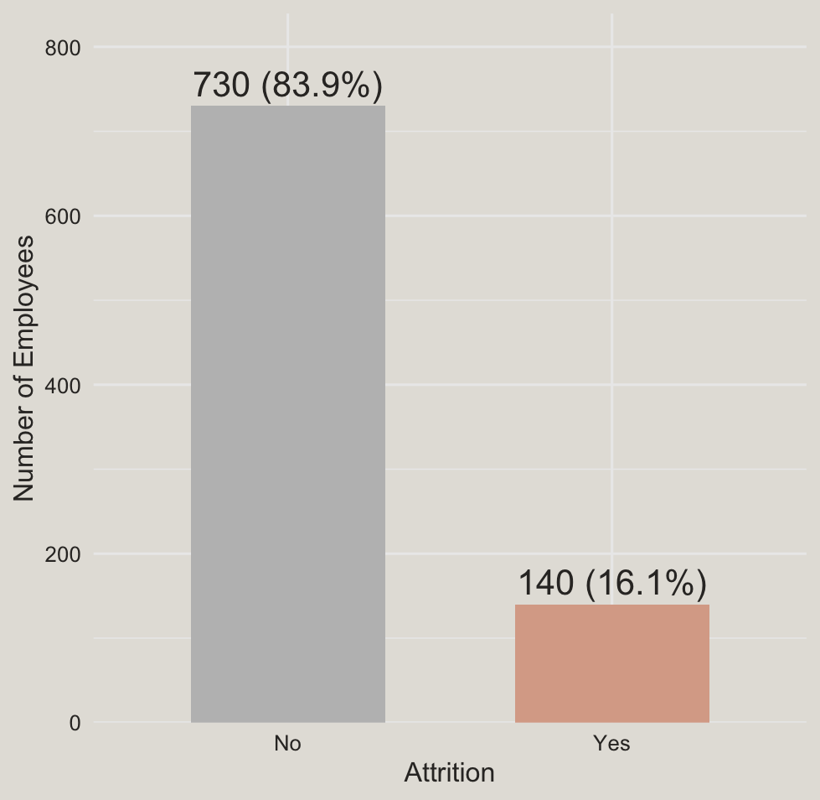
Employee Attrition Affects 16% of the Workforce
Attrition affects a minority of employees, but identifying employees who may leave could help the organization prioritize retention efforts.

Slide 3
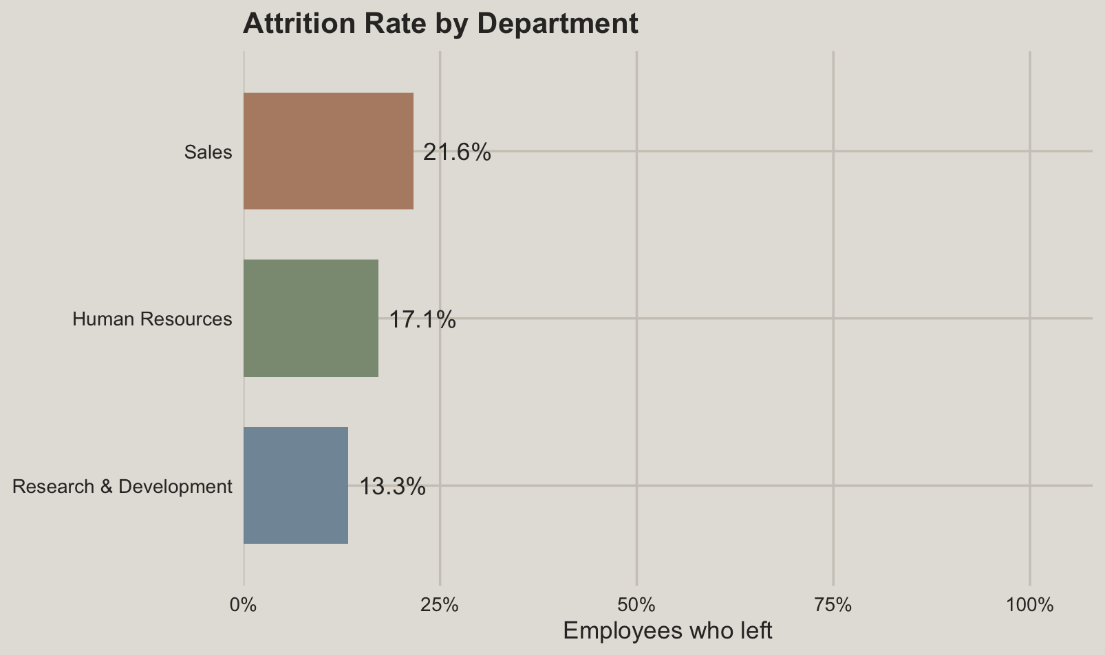
Attrition Rates are highest in the sales department

Slide 4
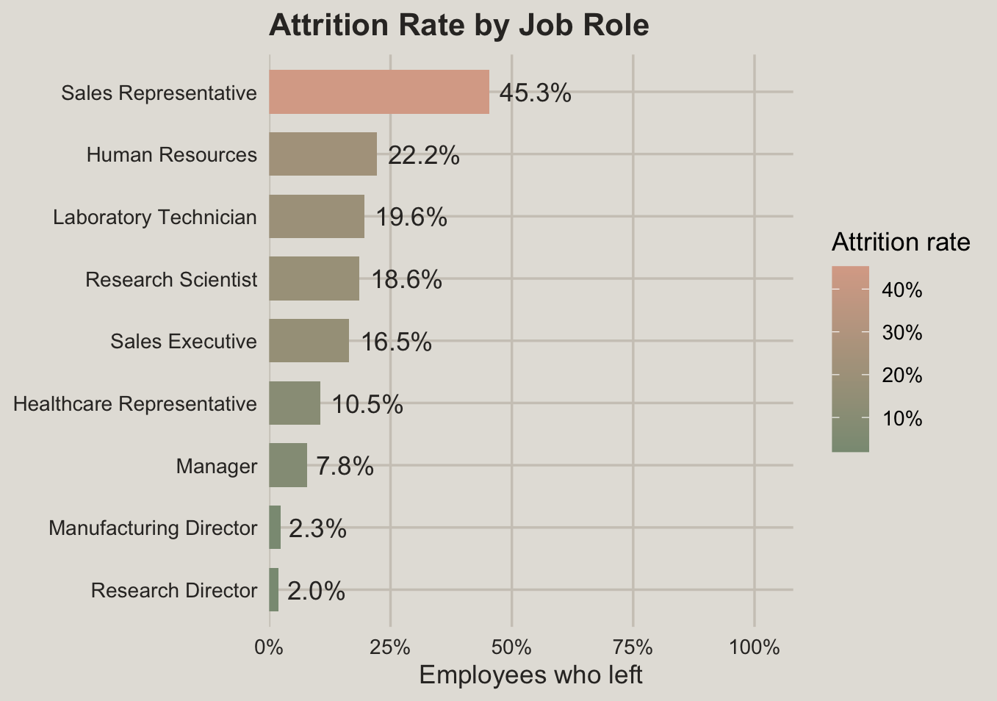
Attrition Rates are highest for sales reps

Slide 5
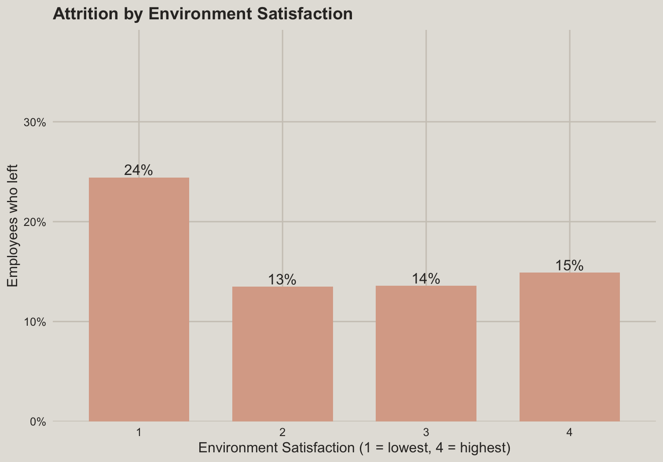
Lowest Environment Satisfaction Is Associated With the Highest Attrition

Slide 6
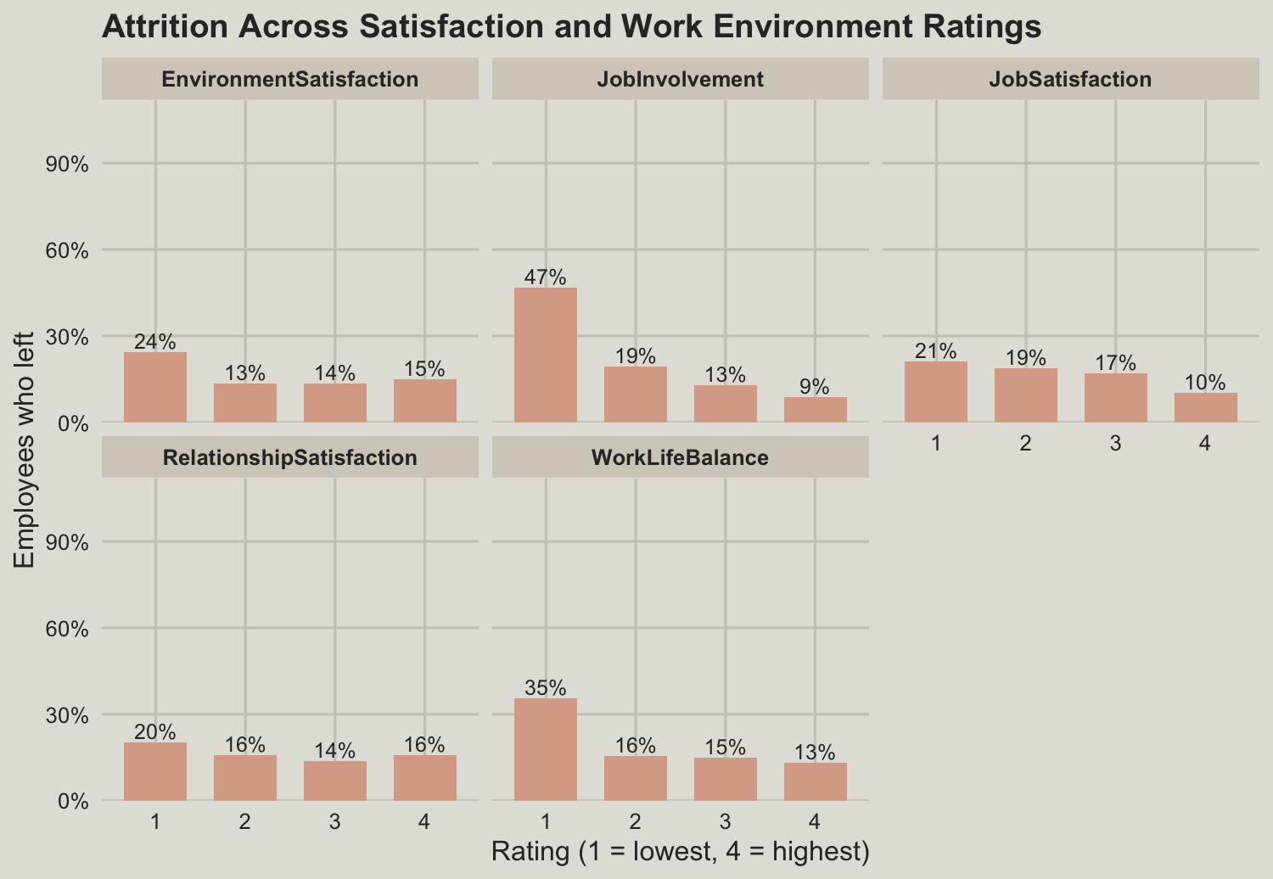
Lower Job Involvement and Work-Life Balance Are Associated With Higher Attrition

Slide 7
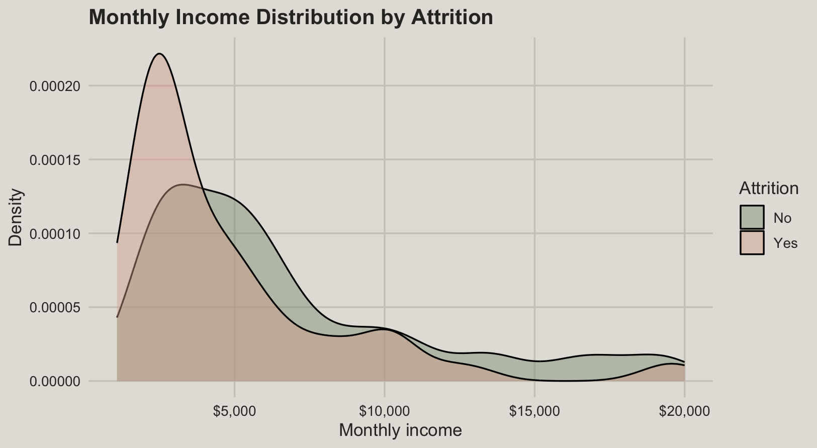
Employees Who Left Tended to Have Lower Monthly Incomes
There is a statistically significant difference in mean monthly income between employees who left and those who stayed ((p < 0.001)).

Slide 8
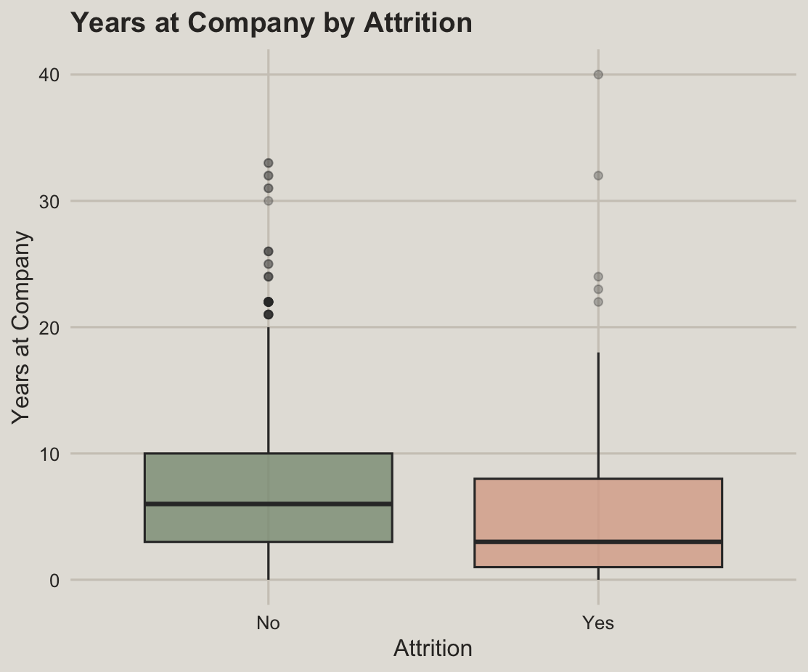
Shorter Company Tenure Is Associated With Higher Attrition

Slide 9
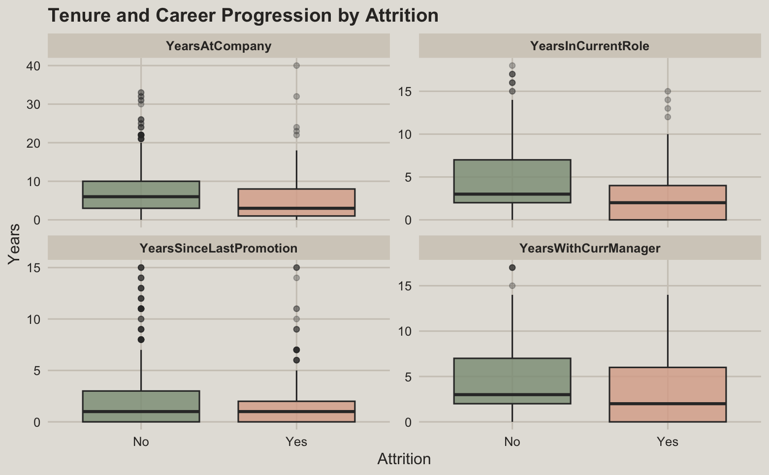
Shorter Role Tenure Is Associated With Higher Attrition

Slide 10
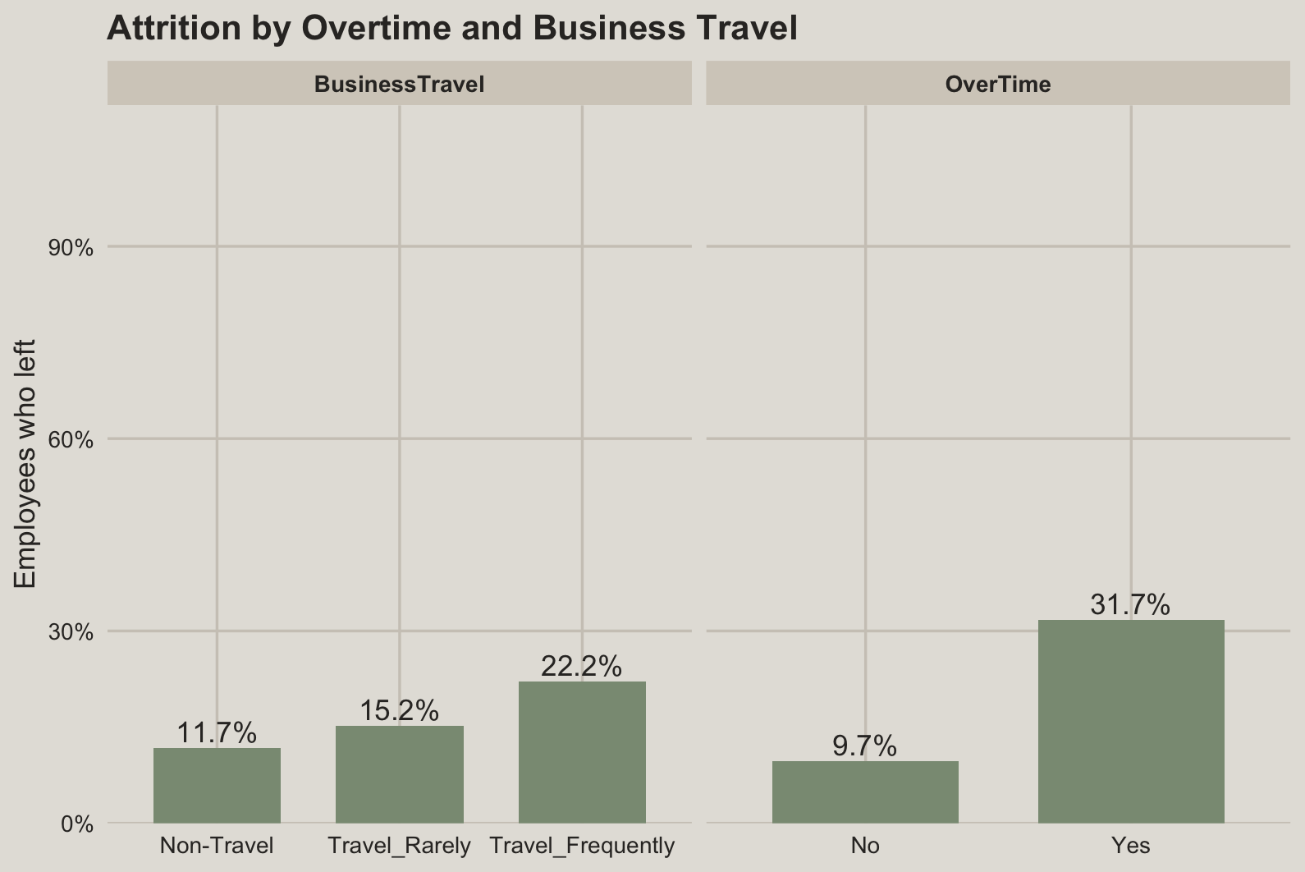
Overtime and Frequent Business Travel Are Associated With Higher Attrition

Slide 11
Models are built with 29 employee factors across 5 areas
Category | Examples
Personal background (6) | Age, Marital status, Distance from home
Role & workload (6) | Job role, Overtime, Business travel
Pay & rewards (6) | Monthly income, Stock options, Salary hike %
Career history (7) | Years at company, Years since promotion, Total experience
Satisfaction (5) | Job satisfaction, Work-life balance, Job involvement

Slide 12
KNN
Accuracy
Sensitivity
Specificity
67%
68%
66%
Out of all 174
employees, about 67%
were classified
correctly by the
model
Of the employees who
actually left the company, the
model correctly
predicts about
68% as employees with attrition
Of the employees who
stayed with the company, the
model correctly
predicts about
66% as employees without attrition

Slide 13
Naïve Bayes
Accuracy
Sensitivity
Specificity
75%
76%
75%
Out of all 174
employees, about 75%
were classified
correctly by the
model
Of the employees who
actually left the company, the
model correctly
predicts about
76% as employees with attrition
Of the employees who
stayed with the company, the
model correctly
predicts about
75% as employees without attrition

Slide 14
Cost Analysis
Metric | No Model | KNN | Naive Bayes
True positives (leavers flagged) | 0 | 17 | 19
False positives (stayers flagged) | 0 | 50 | 37
False negatives (leavers missed) | 25 | 8 | 6
Employees given incentive | 0 | 67 | 56
Incentive cost ($200 each) | $0 | $13,400 | $11,200
Replacement cost (missed leavers × $60k) | $1,500,000 | $480,000 | $360,000
Total cost | $1,500,000 | $493,400 | $371,200
Savings |  | $1,006,600 | $1,128,800
Assumptions: $60,000 median salary cost of replacing a departed employee, $200 incentive is given to every employee the model flags, incentives retain employees

Slide 15
Recommendations
1. Use Naïve Bayes to Identify At Risk Employees
2. Pilot a Retention Program for Sales Representatives
3. Track Retention Outcomes and Return on Investment​

Slide 16
THANK
YOU

